Slide 1

ENSC 833 Project Presentation
Performance Evaluation of machine learning models using IODA data
Mohid Hasan
Student ID: 301588534
Under the supervision of
Professor Ljiljana Trajković
April 2026
Notes:
This is the “Title Slide SFU” layout slide, the logo and red bar is locked. For more flexibility working with these elements see slides 7 and 8.

Slide 2
Motivation
Internet anomalies arise from:
Malware outbreaks (SQL Slammer, WannaCry)
Infrastructure failures (Moscow Blackout)
Conflict-driven connectivity loss (Ukraine, Iraq, Gaza)
Early detection is critical:
Network stability
Cybersecurity visibility
Resilience during crises
Goal: Detect anomalies in IODA outage datasets (Iran and Cuba outage) using ML.
Notes:
This is the “Title and Content” master slide.

Slide 3
Objective
Apply 8 machine learning models for anomaly detection on IODA data.
Use a sliding-window approach to capture temporal dependencies.
Evaluate:
– ROC-AUC, PR-AUC
– Accuracy, F1-score
– TP / FP / FN / TN
– Precision, Sensitivity
– Training time
Compare:
– Deep sequence models (CNN, RNN-GRU, RNN-LSTM, RNN-Bi-GRU, RNN-Bi-LSTM)
– Broad Learning Systems (BLS, VFBLS)
– Tree-based baseline (LightGBM).
Notes:
This is the “Title and Content” master slide.

Slide 4
Key Contributions
• Eight-model benchmark suite for IODA datasets with consistent preprocessing
• Sliding-window based anomaly detection:
– IODA outage signals
• Updated and extended code to support:
– CNN, RNN-LSTM, RNN-Bi-LSTM for IODA data
– Per-model optimal F1 threshold
– Full confusion matrix and metric outputs.
Notes:
This is the “Title and Content” master slide.

Slide 5
Datasets Overview
2 countries: Iran and Cuba, both covering Dec 2025 – Mar 2026 (2,161 hourly rows each)
5 IODA signals per country, normalised to 0–100%: Google Search, BGP Routing, Mozilla City Count, Telescope Unique IPs, Active Probing
Iran: two total internet shutdowns — Jan 8–26 and Feb 28–Mar 19, 2026. Active Probing collapsed from 97% to 3%
Cuba: five partial disruptions between Feb–Mar 2026. Active Probing dropped to 81–88%, baseline already degraded to 94–98%
Total labelled anomalies: Iran 900 rows (41.6%), Cuba 103 rows (4.8%)
Notes:
This is the “Title and Content” master slide.

Slide 6
Models
CNN — Convolutional Neural Network, 12 epochs; extracts local temporal patterns but needs more data for subtle drops
RNN-GRU — Gated Recurrent Unit, 12 epochs; gating reduces vanishing gradient, strong balanced performance
RNN-LSTM — Long Short-Term Memory, 12 epochs; cell state captures long-range dependencies
RNN-Bi-GRU — Bidirectional Gated Recurrent Unit, 15 epochs; reads sequence forward and backward
RNN-Bi-LSTM — Bidirectional Long Short-Term Memory, 15 epochs; best deep learning model on Cuba
BLS — Broad Learning System; closed-form linear solution, no gradient descent, trains in under 0.07s
VFBLS — Variant-Feature Broad Learning System with tanh activation; trains in under 0.003s
GBDT-LightGBM — Gradient Boosted Decision Trees — Light Gradient Boosting Machine, 300 rounds; operates on flattened windows
Notes:
This is the “Title and Content” master slide.

Slide 7
Process
Step 1 — Load and sort data by timestamp
Step 2 — Label disruption windows: hours inside verified outages → LABEL=1, all others → LABEL=0
Step 3 — Impute missing values (median per column), then Z-score normalise all features
Step 4 — Feature selection using ExtraTreesClassifier — keeps only the most informative signals
Step 5 — Sliding window of W=10 hours per sample; each window's label = its final hour's label
Step 6 — Chronological 70/30 split: first 70% for training, last 30% for testing, no shuffling — prevents data leakage and reflects real deployment conditions
Notes:
This is the “Title and Content” master slide.

Slide 8
Performance metrics
Receiver Operating Characteristic — Area Under Curve (ROC-AUC) — Area under the curve of True Positive Rate vs False Positive Rate across all thresholds. 1.0 = perfect, 0.5 = random
Precision-Recall — Area Under Curve (PR-AUC) — Area under the curve of Precision vs Recall across all thresholds. More honest than ROC-AUC when anomalies are rare
Accuracy — % of all hours correctly classified
F1-Score — Harmonic mean of Precision and Sensitivity
Precision — Of all hours flagged as disruptions, how many were actually disruptions
Sensitivity (Recall) — Of all actual disruption hours, how many did the model catch
Training Time — Seconds to fit the model
Notes:
This is the “Title and Content” master slide.

Slide 9
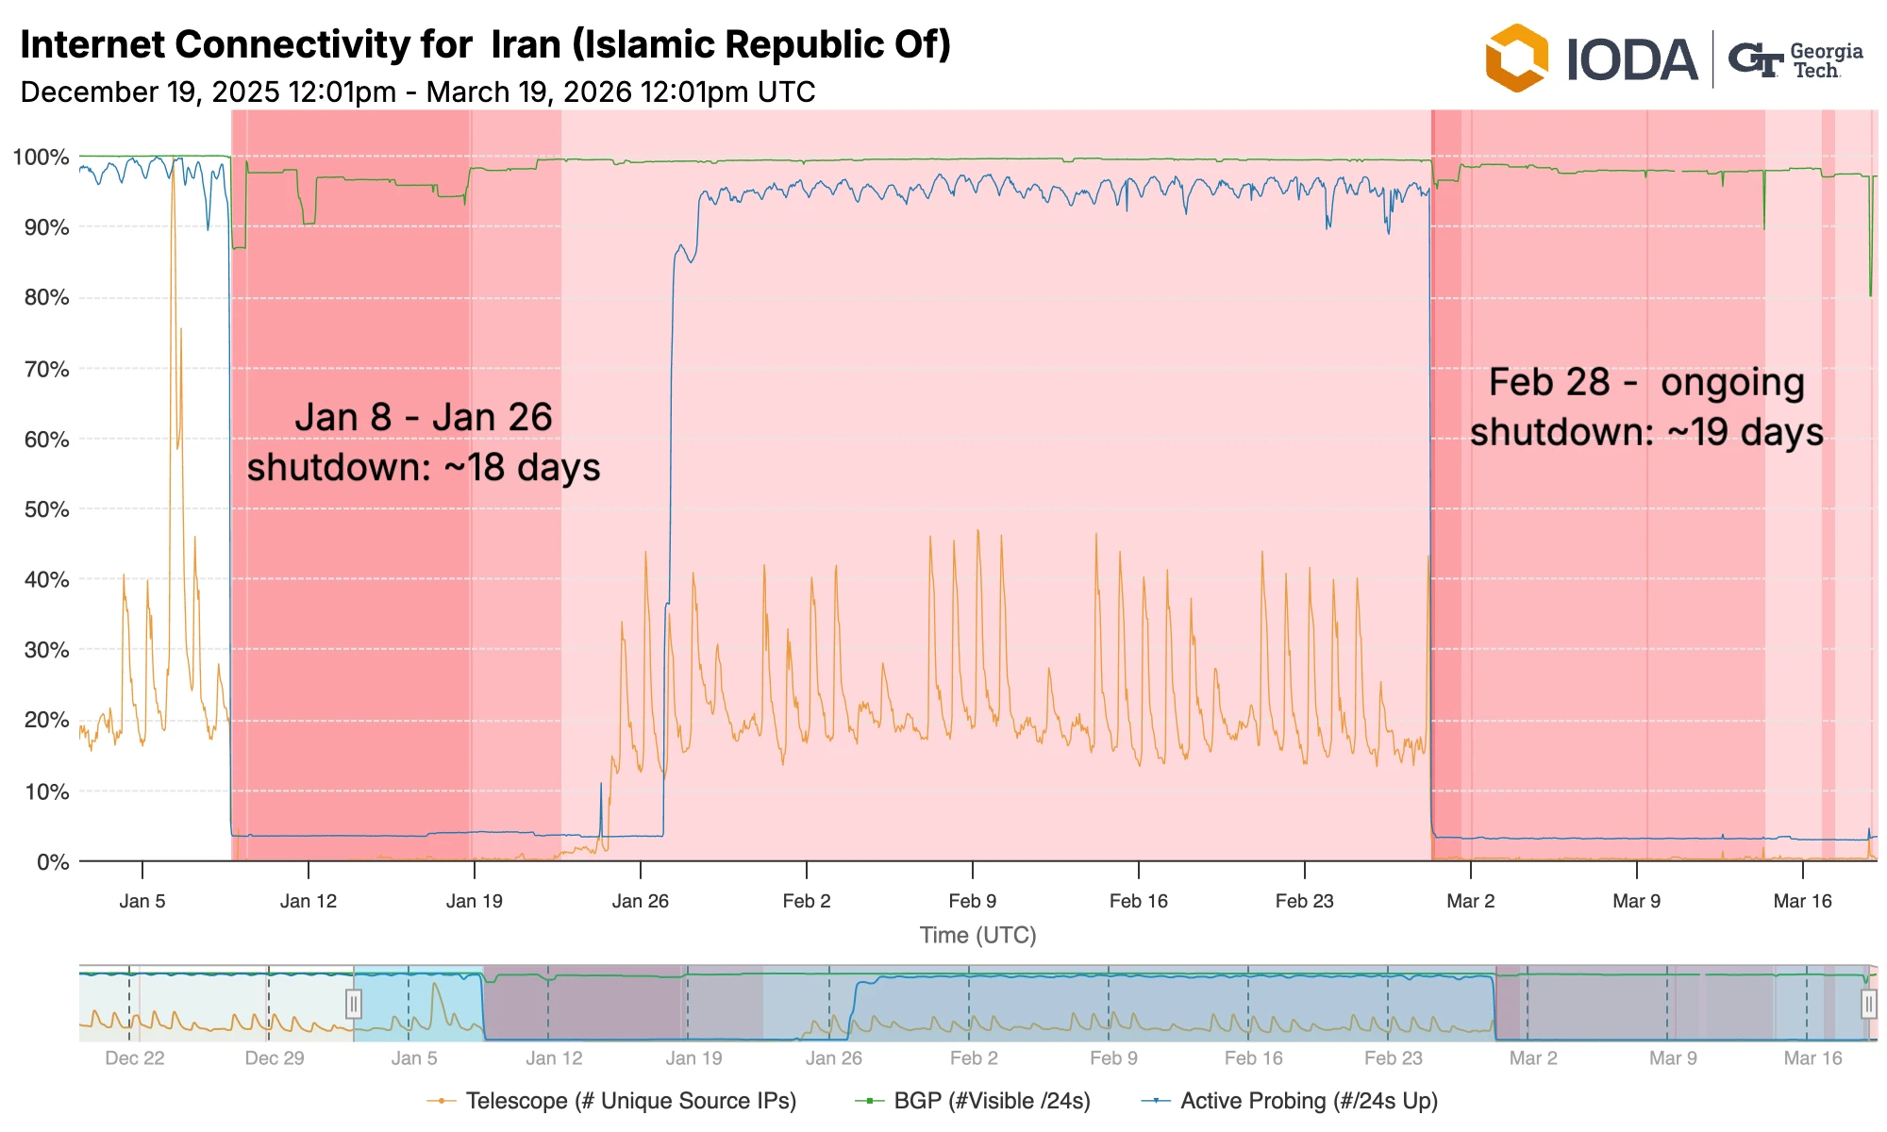
Internet Connectivity for Iran (Dec 2025-Mar 2026)
Notes:
This is the “Title and Content” master slide.

Slide 10
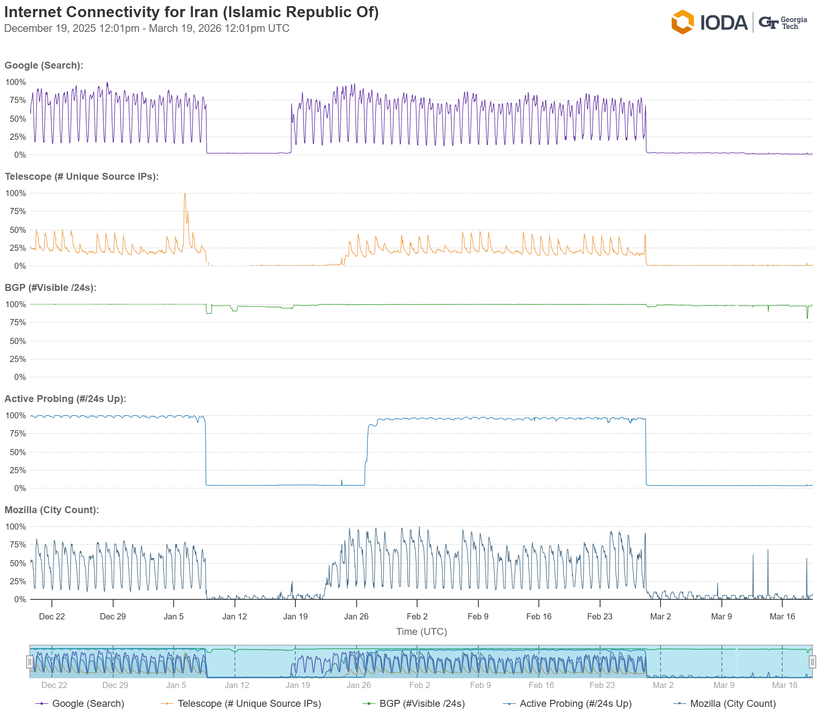
Internet Connectivity - Iran

Slide 11
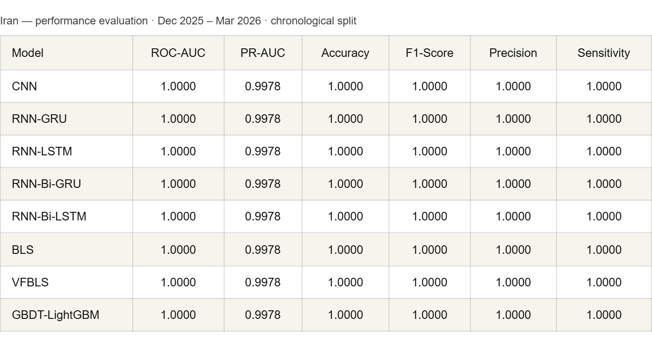
Iran-performance

Slide 12
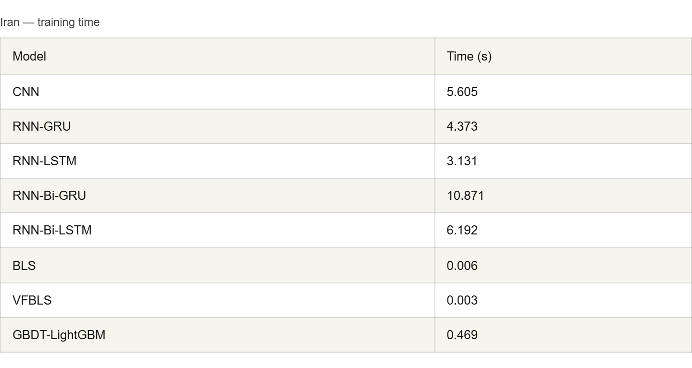
Iran-training time

Slide 13
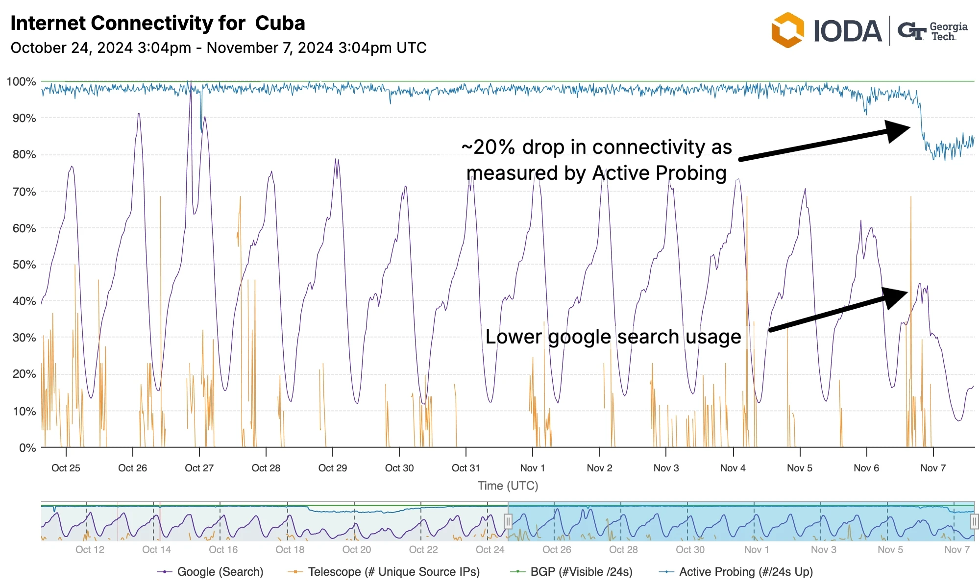
Internet Connectivity for Iran (Dec 2025-Mar 2026)
Notes:
This is the “Title and Content” master slide.

Slide 14
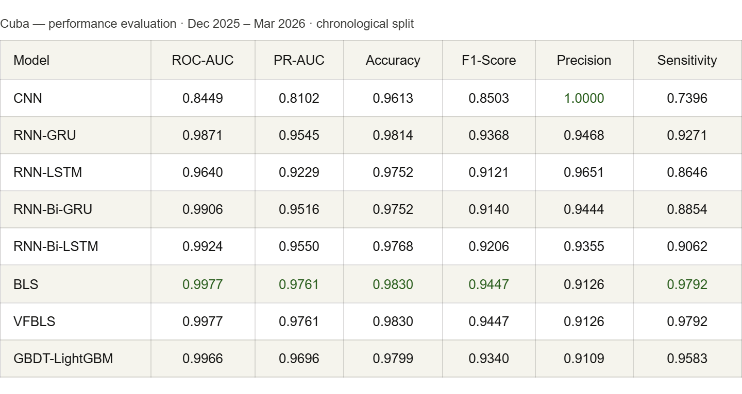
Cuba-Performance

Slide 15
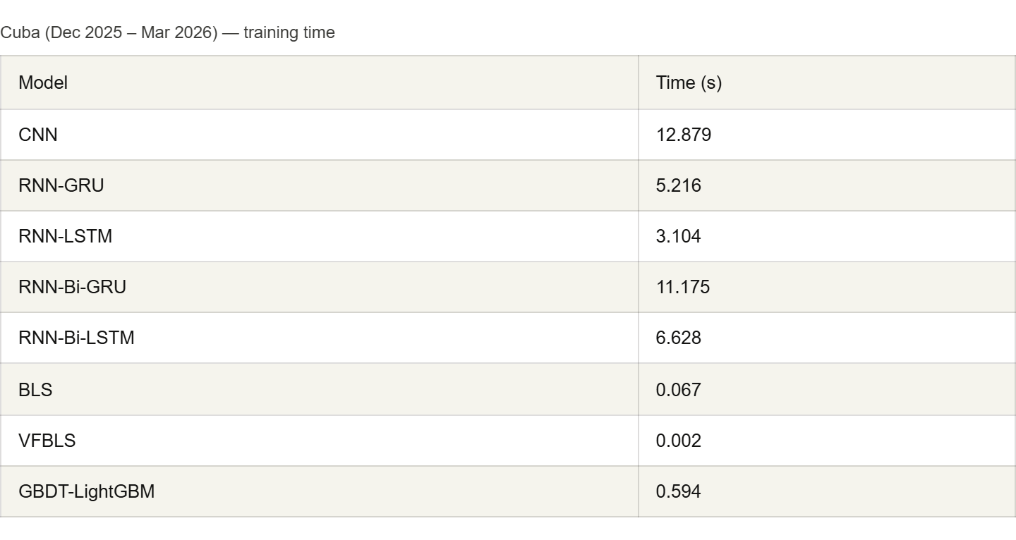
Cuba-training time

Slide 16
Summary
The framework generalizes across countries, disruption severities, and time periods
Signal severity determines task difficulty: total shutdowns (Iran) are detectable by any model; subtle degradations (Cuba 2026) reveal true model differences
BLS and VFBLS consistently deliver near-top accuracy at training times under 0.1 seconds — strong candidates for real-time deployment
RNN-GRU and RNN-Bi-LSTM are the best and balanced deep learning models across all datasets
CNN underperforms on shorter, subtler disruptions — not recommended when training data is limited
The sliding window approach (window size = 10 hours) successfully captures temporal disruption patterns across all datasets

Slide 17
Thank you
Notes:
This is the “Divider” layout slide.
This file was last updated 20250402.

